Slide 1
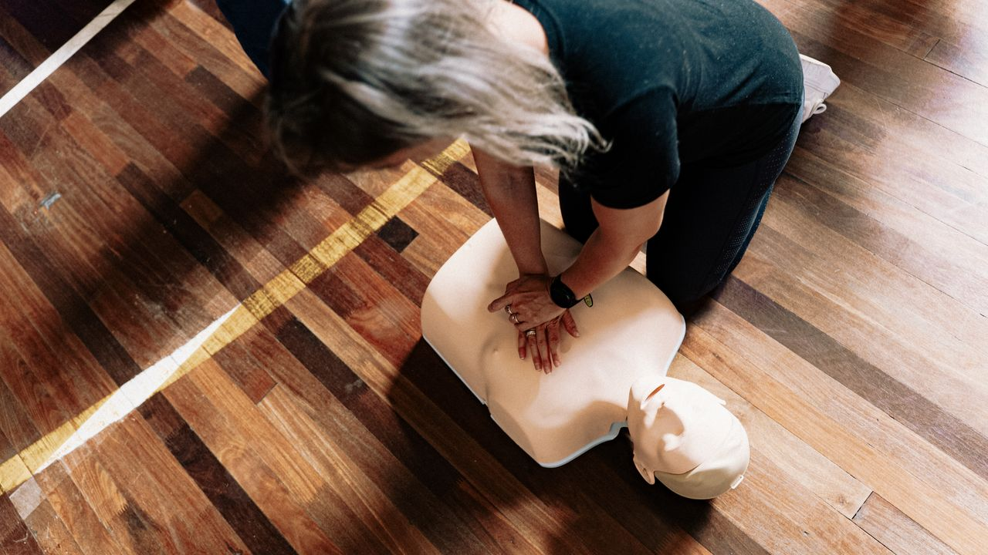
CPR and
Emergency Response
Grades 10–12
Together For Health

Slide 2
350,000
Canadians experience cardiac arrest outside hospital annually — only 10% survive
Improving bystander CPR rates from 40% to 60% would save thousands of lives per year.
Together For Health

Slide 3
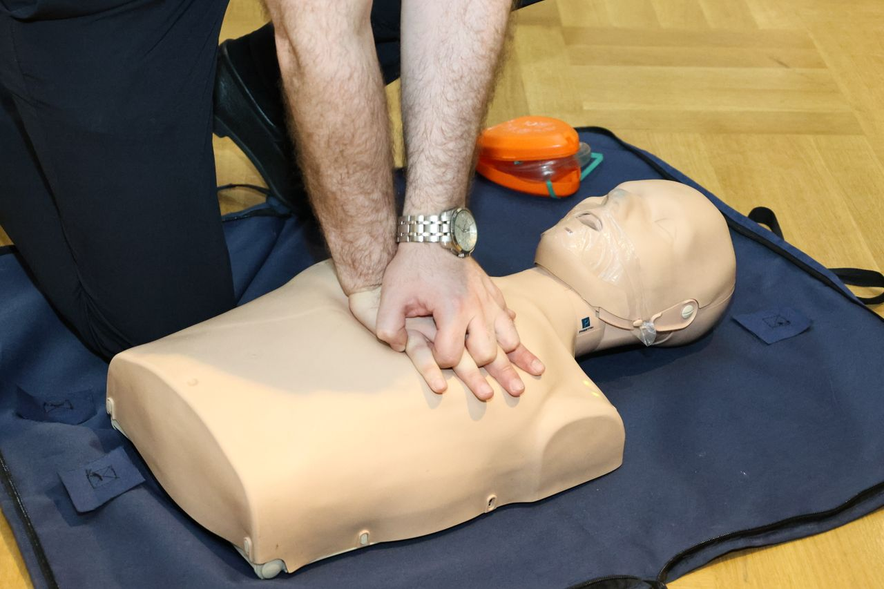
🧬
The Physiology of Cardiac Arrest
Ventricular fibrillation (VF): chaotic, ineffective heart contractions — most common cause
Pulseless ventricular tachycardia (VT): rapid but ineffective
Asystole: flatline — poor prognosis even with treatment
Pulseless electrical activity (PEA): electrical activity without effective pumping
CPR goal: maintain coronary perfusion pressure until defibrillation restores rhythm
Together For Health

Slide 4
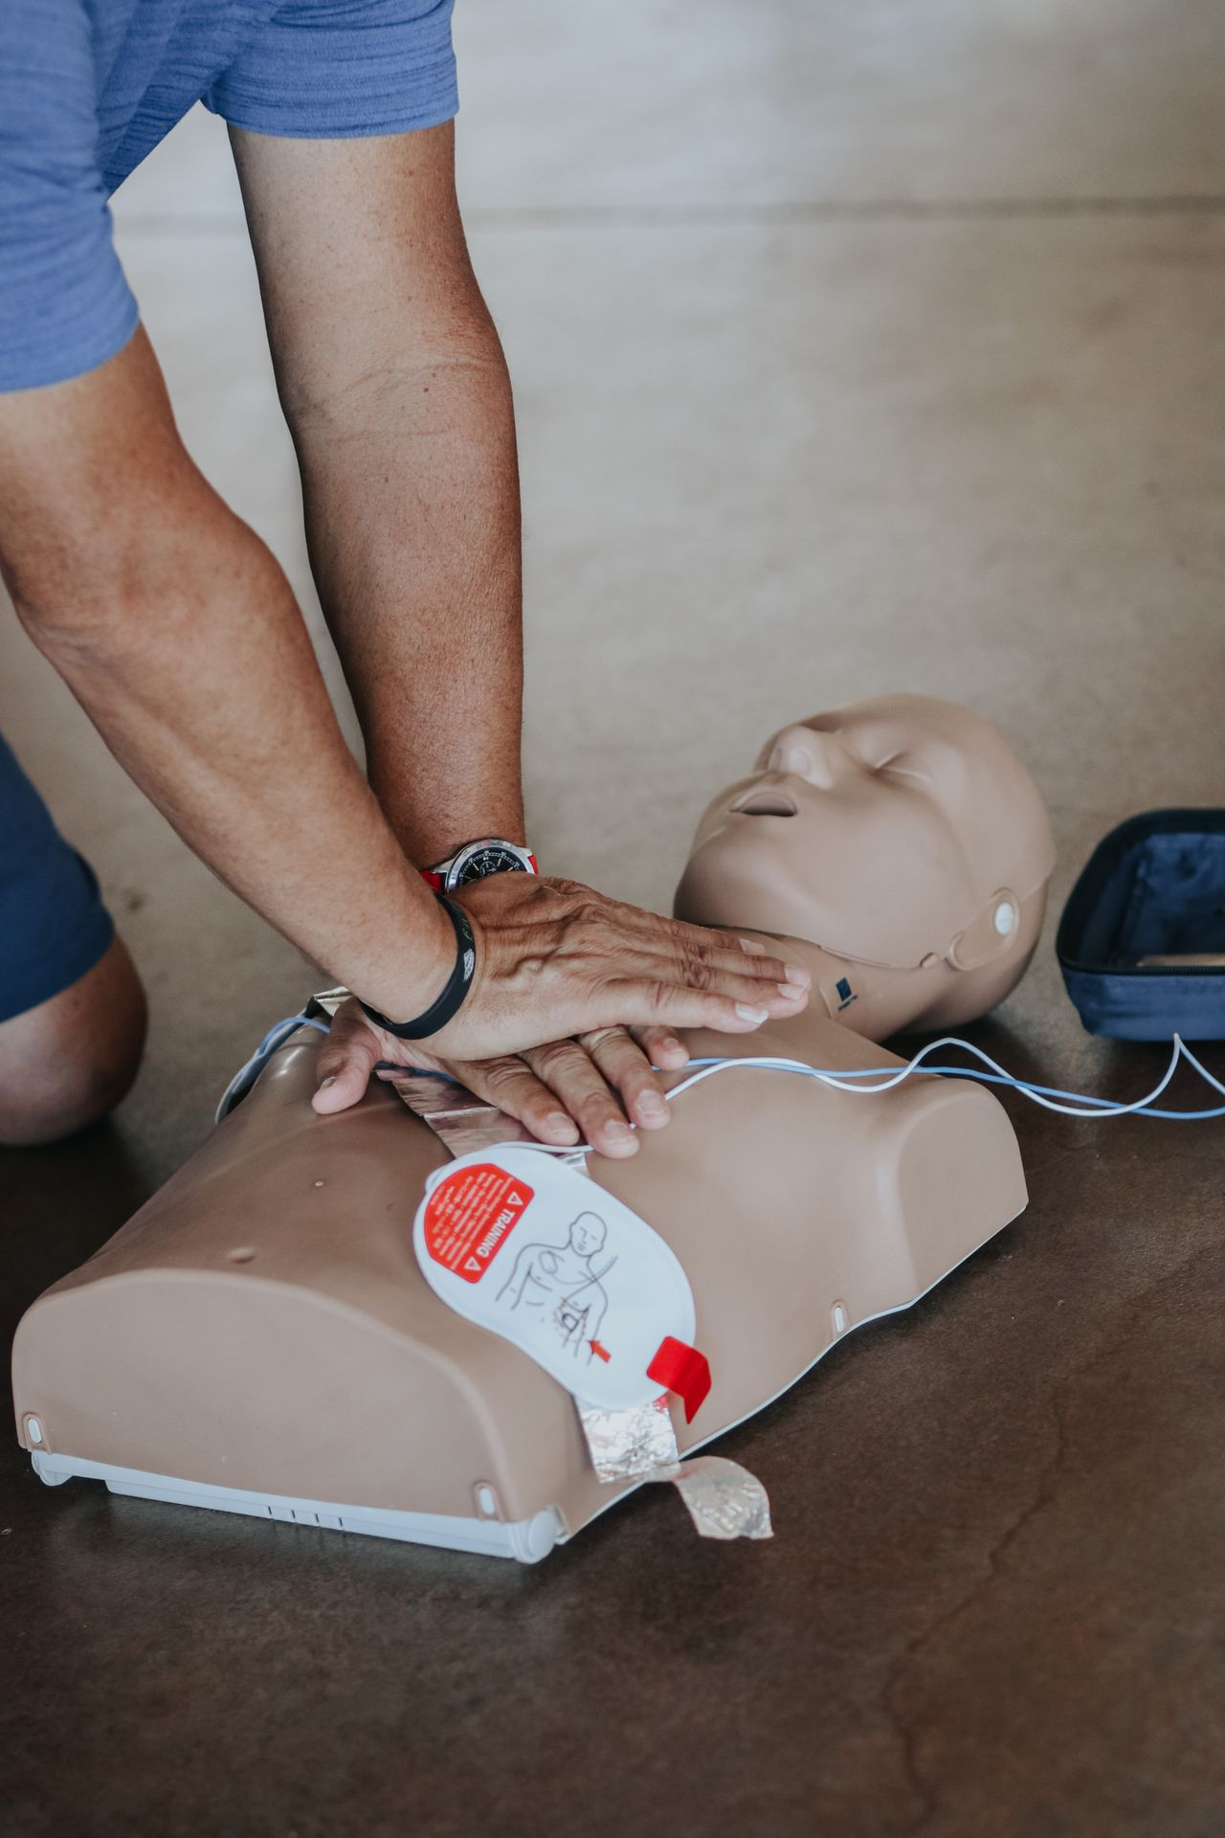
🏥
Advanced Chain of Survival
Early recognition: identify unresponsiveness + abnormal breathing
1
Immediate 9-1-1 activation: dispatch can guide CPR by phone
2
High-quality CPR: rate 100–120 bpm, depth 5–6 cm, full recoil, minimal interruptions
3
Early defibrillation: AED within 3–5 min for witnessed VF — key determinant of survival
4
Advanced care: paramedic interventions, hospital ACLS protocol
5
Together For Health

Slide 5
⚡
High-Quality CPR — What the Evidence Shows
Compression rate 100–120 bpm: metronome or "Stayin' Alive" (103 bpm)
Depth 5–6 cm (2–2.4 in): inadequate depth is the most common CPR error
Full chest recoil between compressions: leaning on chest reduces effectiveness
Minimize interruptions: limit pauses to <10 seconds (e.g., for defibrillation)
2:30 compression-to-ventilation ratio for untrained bystanders: compressions only
Together For Health

Slide 6
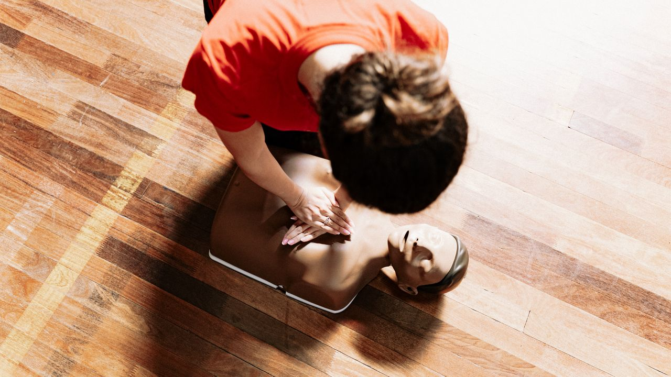
⚖️
The Legal Reality
Good Samaritan laws protect bystanders who provide CPR in good faith in all Canadian provinces.
You cannot be sued for trying. The legal risk of not acting (and someone dying) is far greater.
Together For Health

Slide 7
KEY TAKEAWAYS
CPR competency should be universal — consider getting certified today
✓
High-quality compressions are the most important thing you can do
✓
You now have the knowledge — the next step is practice and certification
✓
Resources
Heart & Stroke CPR: heartandstroke.ca
St. John Ambulance: sja.ca
Red Cross First Aid: redcross.ca/firstaid
Together For Health

